Slide 1

Computer System Servicing

Slide 2

Motivation:

Slide 3
Components of Client/Server Network Design

Slide 4

Components of Client/Server Network Design
INTERNET SERVICE PROVIDER (ISP)
An organization that provides services for accessing, or participating in the internet. ISP can be organized in various forms, such as commercial, community-owned, non-profit, or otherwise privately owned.

Slide 5
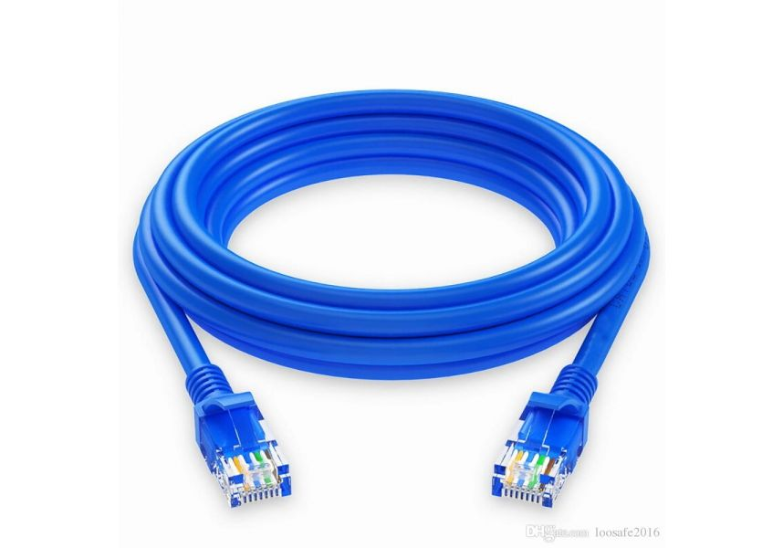
Components of Client/Server Network Design
2. NETWORK CABLE
Use to connect one network device to other network device or to connect two or more computers to share files and printer.

Slide 6
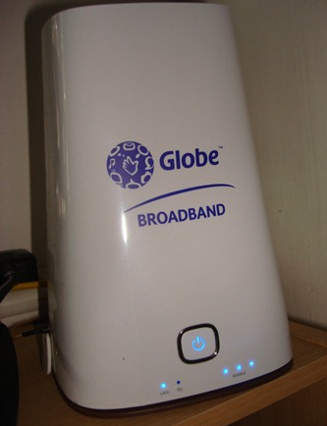
Components of Client/Server Network Design
3. MODEM
A device that converts data into a format suitable for a transmission medium so that it can be transmitted from one computer to another.

Slide 7
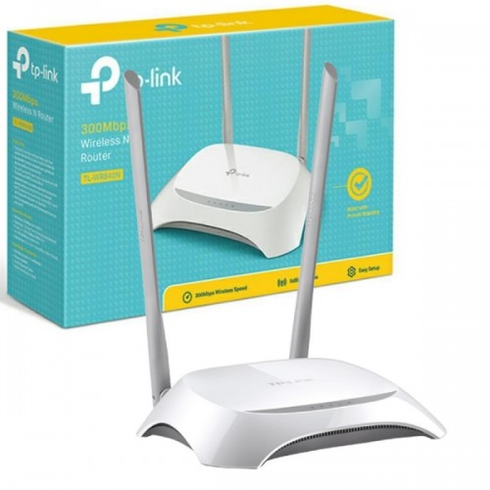
Components of Client/Server Network Design
4. ROUTER
A device that forwards data packets between computer networks.

Slide 8

Components of Client/Server Network Design
5. PERSONAL COMPUTER (PC)
A multi-purpose computer whose size, capabilities, and price make it feasible for individual use.

Slide 9
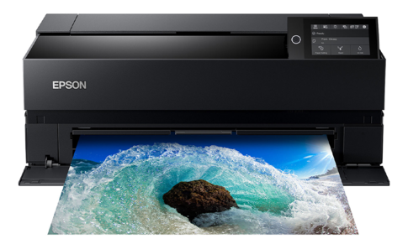
Components of Client/Server Network Design
6. PRINTER
A peripheral device which makes a persistent representation of graphics or text, usually on paper.

Slide 10
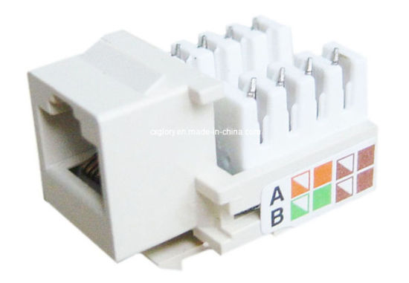
Components of Client/Server Network Design
7. I/O Jack or Krone Jack
Use for telephone systems, data networks, and low-speed serial connections.

Slide 11
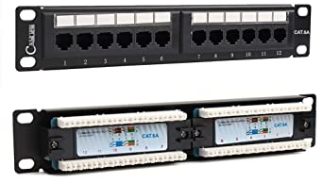
Components of Client/Server Network Design
8. Patch Panel
A bundle of multiple network ports together to connect incoming and outgoing lines including those for local area networks, electronics, electrical systems and communication.

Slide 12
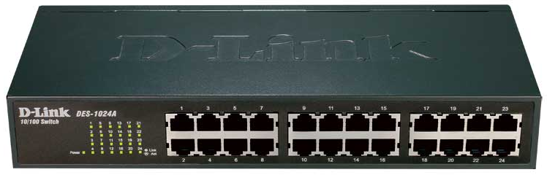
Components of Client/Server Network Design
9. HUB/Switch
A device that filters and forwards data packets between LAN segments.

Slide 13
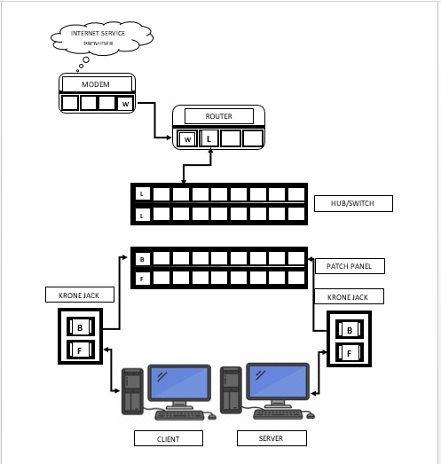
Cable routes of Client/Server Network Design

Slide 14
FORMATIVE ASSESSMENT
Direction: Cite the cable routes in Peer to Peer Network Type.
Available Devices:
1. Modem
2. Router
3. ISP
4. HUB/Switch
5. 2 sets of PC
6. Network Cables
7. Patch Panel
8. Krone Jack

Slide 15
Practical Application of the acquired
Learning Competencies

Slide 16

GENERALIZATION

Slide 17
THANK YOU!!!

